Slide 1
University Health Network
DISCHARGE SUMMARY
V2.0

Slide 2
The importance of a DISCHARGE SUMMARY and best practices to ensure timely & accurate completion
2

Slide 3
ALIGNMENT WITH THE cANmeds FRAMEWORK
COMMUNICATORS
Timely Discharge Summary delivery to subsequent care providers reduces adverse events post-discharge by 20%
HEALTH ADVOCATES
The Discharge Summary is critical to patient outcomes and reduces the risk of re-hospitalization when a patient is provided with a timely follow-up
PROFESSIONALS
The Discharge Summary improves the patient experience and Continuity of Care
3

Slide 4
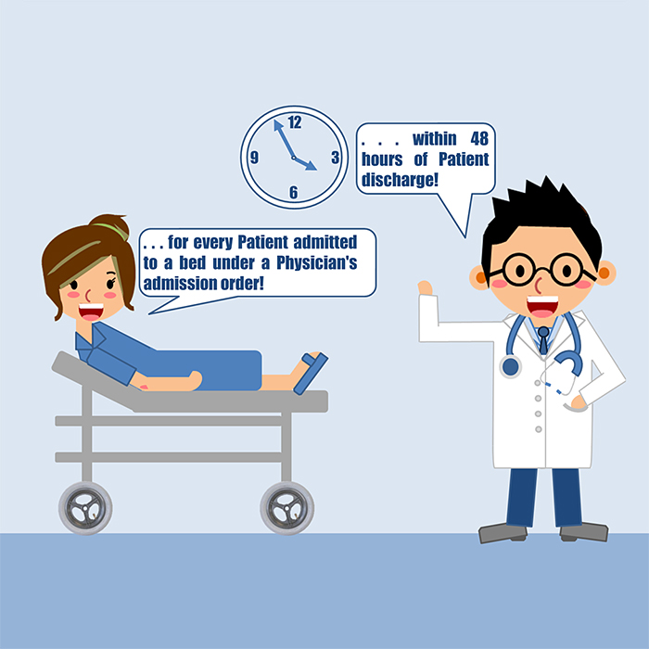
AT UHN, A DISCHARGE SUMMARY IS COMPLETED……

Slide 5
USE THE A-B-C METHOD
Apply the UHN Standard
To make it more efficient for you to complete a Discharge Summary
Be concise
Only include information to ensure Continuity of Care by the subsequent provider
Communicate
Discuss the Discharge Summary with the patient and his or her Circle of Care

Slide 6
DO’S & DON’TS
✓ Start on Day 1 of the patient’s stay
✓ Document course of stay chronologically
✓ Tailor information to each patient/
situation
✓ Consider what information you would like
to receive as a Provider
✓ Be concise and succinct - use point-form
✗ Don't include all lab/imaging results (only
those most relevant to follow-up care)
✗ Don't use abbreviations/acronyms
✗ Don't include assumptions/inferences
✗ Don't exceed more than 3 pages
✗ Don't rotate off a unit without updating
the patient’s Discharge Summary

Slide 7
BEFORE YOU COMPLETE YOUR FIRST DISCHARGE SUMMARY, PLEASE VISIT
http://www.uhnmodules.ca/DischargeSummary/

Slide 8
ACKNOWLEDGEMENTS & REFERENCES
Diana Toubassi, MD, CCFP & David Frost, MD, FRCP(C). Discharge Summaries – enhancing continuity of care. Toronto, ON.
Karim Taha & David Frost, MD, FRCP(C), Centre for Excellence in Education and Practice & University of Toronto (2015). Discharge Summary Checklist. Toronto, ON.
Brian Davidson, Faculty of Medicine, University of Toronto & Wightman-Berris Academy, Undergraduate Medical Education (2015). Visiting Elective Student & Medical Student Orientation. Toronto, ON.
Nadia Okolowsky, University Health Network (UHN) Medical Education Office (2015). Resident and Fellow Placement Pre-registration/Registration Communication. Toronto, ON.
C. van Walraven, R. Seth, P. C. Austin, and A. Laupacis, Journal of General Internal Medicine, 17 (3):186-192 (2002). Effect of discharge summary availability during post-discharge visits on hospital readmission.
C. van Walraven and E. Rokosh, American Journal of Medical Quality 14 (4):160-169 (1999). What is necessary for high-quality discharge summaries?
Cleveland Clinic (2013). Graduate Physician Policy Manual. Florida, U.S.A.
College of Physicians and Surgeons of Ontario (2000). Medical Records. Toronto, ON
Ministry of Health and Long-Term Care (2012). Discharge of Hospital Patients. Toronto, ON.
Mid-West Toronto Health Link (2013). Nine Interventions for Ensuring Primary Care Follow-Up within 7 Days of Discharge. Toronto, ON.
OPENLAB (2014). PODS Patient Oriented Discharge Summary. Toronto, ON.
Physician Documentation Expert Panel, Ministry of Health and Long-Term Care (2006). A Guide to Better Physician Documentation. Toronto, ON.
The Canadian Medical Protective Association (2011). Why good documentation matters. Ottawa, ON
The Canadian Medical Protective Association (2014). The post-operative period —Patient discharge and follow-up. Ottawa, ON.
The Children’s Hospital of Eastern Ontario (2011). Resident Orientation Manual. Ottawa, ON.
The Royal College of Physicians and Surgeons of Canada (2005). CanMEDS 2005 Framework. Ottawa, ON.
Toronto Central Local Health Integration Network (TC LHIN) (2015). Standardized Discharge Summary Template. Toronto, ON.
Toronto Central Local Health Integration Network (TC LHIN) (2014). TC LHIN Standardized Discharge Summary. Toronto, ON.
University Health Network (UHN) Health Records and Transcription Services (2015). Discharge Summary Dictation Guidelines. Toronto, ON.
University Health Network (UHN) Student Services Centre (2015). UHN Nursing Placement Handbook. Toronto, ON.

